Slide 1


BATCH 26
Inceptez Data Science Presents
Python Day - 6
Laxmi Narayen Nagarajan Venkatesan
03th-May-2026

Slide 2




NUMPY 101
NumPy: The Core of Scientific Computing
What is NumPy?
Why Arrays over Lists?
NumPy (Numerical Python) is the fundamental package for scientific computing in Python. It provides a powerful N-dimensional array object and tools for integrating C/C++ and Fortran code.
Performance: Vectorized operations are significantly faster than Python loops.
Memory Efficiency: Arrays use less space and are stored in contiguous memory.
Functionality: Advanced mathematical, algebraic, and statistical operations.
"While Python lists can hold different data types, NumPy arrays are homogeneous, allowing for optimized computation."

Slide 3

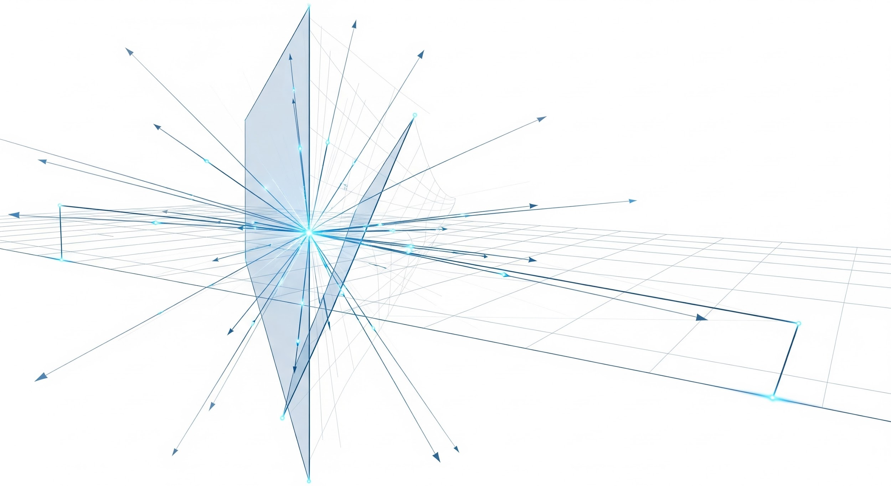
TOPIC 01
Linear Algebra: The Language of AI
Introduction to Linear Algebra
How NumPy Powers Linear Algebra
Linear algebra is the mathematical framework that allows us to represent and manipulate data efficiently. In AI, every image, word, or recommendation is a vector or a matrix.
Vectorization
Perform operations on entire arrays at once, eliminating slow Python for-loops.
Matrix Operations
Built-in support for dot products, determinants, and matrix inversions via np.linalg.
Broadcasting
Manipulate arrays of different shapes effortlessly during arithmetic operations.

Slide 4


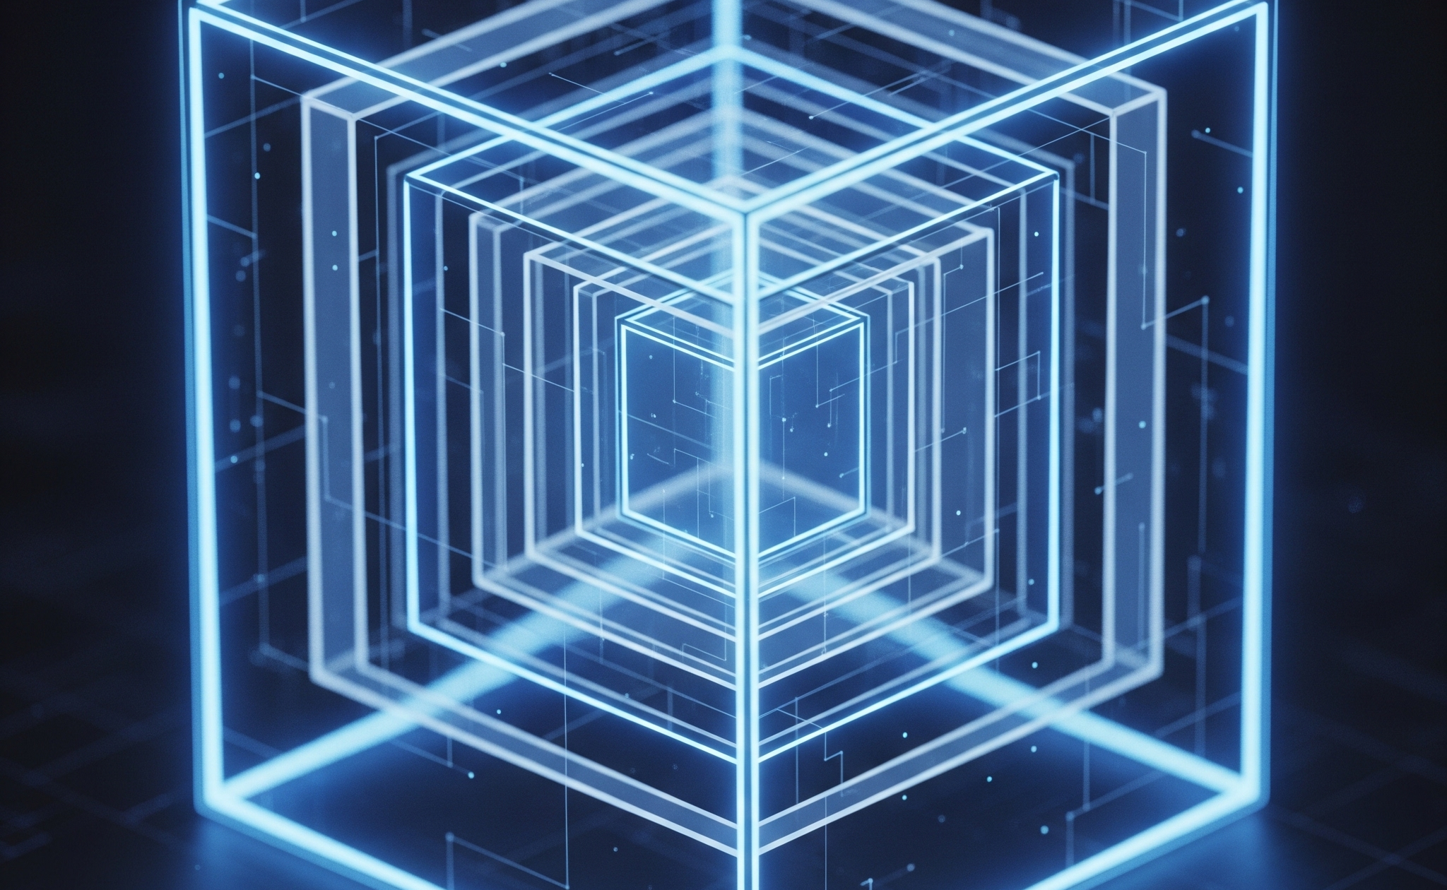
TOPIC 02
From Vectors to Tensors: Array Dimensions
1D: Vectors
2D: Matrices
3D+: Tensors
A sequence of numbers representing a single axis of data (rank-1 array).
Data arranged in rows and columns, like a spreadsheet (rank-2 array).
Multi-dimensional arrays used for complex data like RGB images or video.
np.array([1, 2, 3])
np.array([[1,2],[3,4]])
np.zeros((2, 2, 2))

Slide 5



TOPIC 02
Array Creation & Data Types
Initialization Methods
The 'dtype' Argument
Random & Placeholder
Create arrays from lists, ranges, or pre-filled structures. Essential for setting up your data pipeline.
Control memory usage and precision. Common types include int32, float64, complex128, and bool.
Generate arrays with random values or placeholders like 'empty' for high-performance memory allocation.
np.array() | np.arange()
dtype='float32'
np.random.rand(3,3)

Slide 6
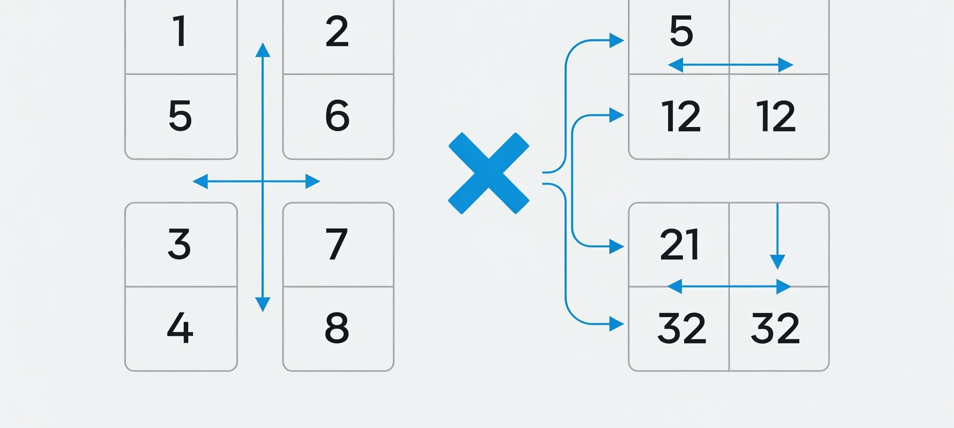

TOPIC 03
Multiplication vs. Dot Product
Element-wise Multiplication
Matrix Dot Product
Standard multiplication (*) performs operations on corresponding elements. Arrays must have compatible shapes.
Calculates the sum of products of rows and columns. This is the fundamental operation for neural networks.
a * b # or np.multiply(a, b)
a @ b # or np.dot(a, b)

Slide 7
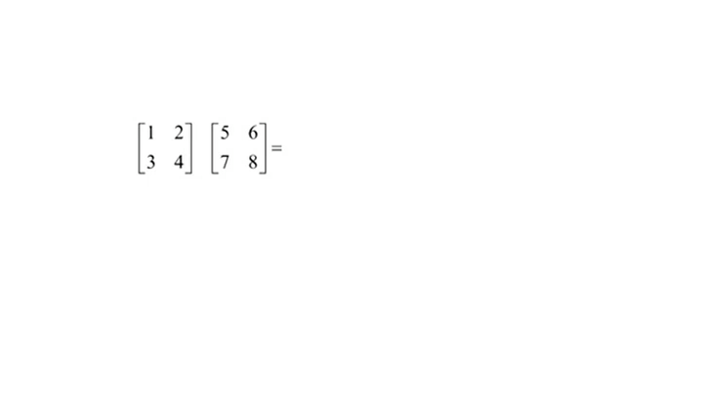

Slide 8
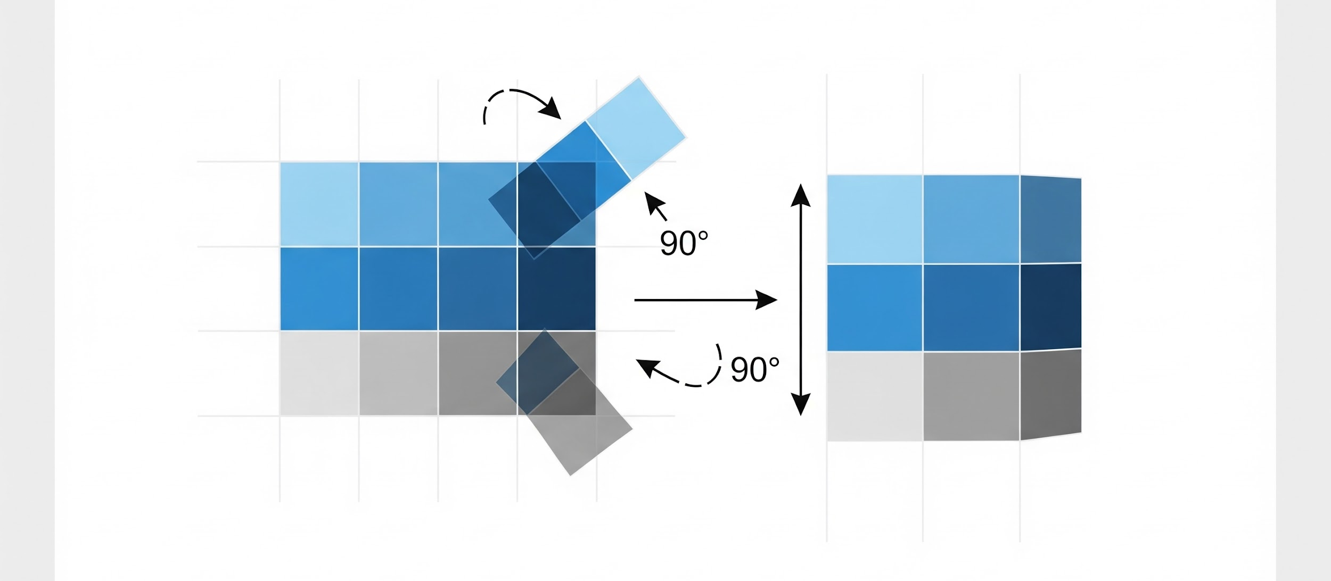
TOPIC 04
Transposition: Swapping the Axes
The Mechanics of array.T
Vital for Data Alignment
Transposition flips a matrix over its main diagonal, switching row indices with column indices. This is essential for restructuring data to meet matrix multiplication requirements.
Dimension Matching
Aligns the inner dimensions of two matrices $(n \times m) \cdot (m \times p)$ for valid dot products.
Feature Engineering
Easily switch between "Samples per Column" and "Samples per Row" formats.
Neural Networks
Crucial for backpropagation to orient weight gradients correctly against input data.
matrix.T # or np.transpose(matrix)

Slide 9



TOPIC 05
Special Matrices: Structural Patterns
Identity & Constant
Diagonal Matrices
Triangular Matrices
Identity (I) has 1s on diagonal, 0s elsewhere. Ones and Zeros matrices are filled with a single value.
Only elements on the main diagonal can be non-zero. Essential for scaling operations and eigenvalues.
Upper (all below diag is 0) and Lower (all above diag is 0). Used in LU decomposition and solving systems.
np.eye(3) | np.ones((3,3))
np.diag([1, 2, 3])
np.triu(a) | np.tril(a)

Slide 10
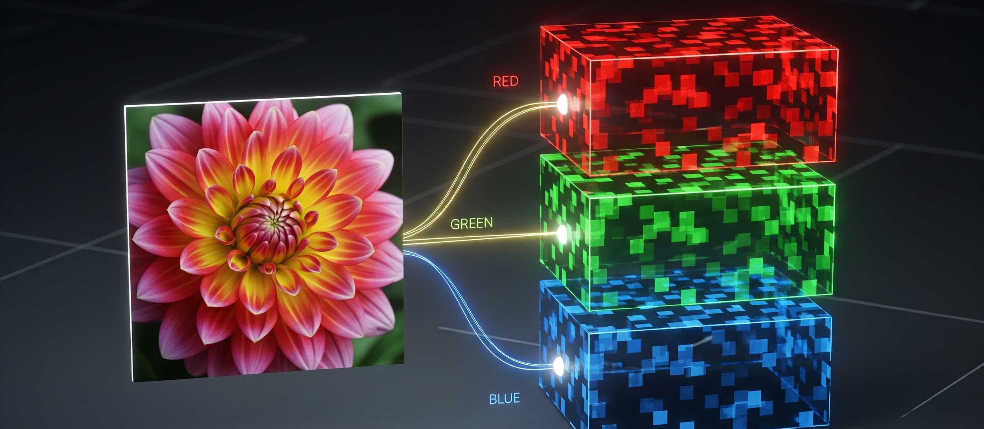
TOPIC 06
Images are Tensors
The Digital Representation
Shape: (C, H, W)
To a computer, an image is just a grid of numbers representing pixel intensities. Grayscale is a 2D matrix; RGB is a 3D tensor.
Channels (C)
Typically 3 for RGB or 1 for Grayscale. Defines the depth.
Spatial Dimensions (H, W)
Height and Width in pixels. A 1080p image is 1920x1080.
Batch Size (N)
Neural networks process stacks of images: (N, C, H, W).
img_tensor = torch.tensor(image)

